Slide 1
STUDY ON ADVANCED TOPICS Flow Extraction from mobile Data Packets for the purpose of user activity / behaviour classification
Devamalya Hazra
Mohit Agarwal
Rishabh Sharma
Shubham Bansal
M.E. Software Systems
BITS Pilani, Department of Computer Science and Information Systems

Slide 2
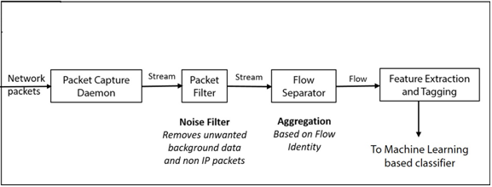
Phases
Packet Capture
Packet Filtration
Flow Separator
Feature Extraction

Slide 3
Phases
Packet Capture
tcpDump with Android Debug Bridge (ADB)
Involves usage of ADB script.
Easier to tag in-app activities.
Not possible to simulate real usage.
Requires Root access of the device.
TinyProxy
Intercepts network data at a centralized server
Accessible via sniffing utilities.
Feasible to scale.
Requires isolation of the running app from the background activities
to guarantee app-specific data packets.
Packet Filtration
Flow Separator
Feature Extraction

Slide 4
Phases
Packet Capture
Packet Filtration
Removes unnecessary data.
Background data of proxy server
Non-IP packets like SSDP and ARP.
Used python scripts (scapy) to parse the .pcap files
Flow Separator
Feature Extraction

Slide 5
Phases
Packet Capture
Packet Filtration
Flow Separator
Identify flow definition.
Identifies unique flows from the packet stream.
Flows to be associated with user activities in the later stages.
Feature Extraction

Slide 6
Phases
Packet Capture
Packet Filtration
Flow Separator
Feature Extraction
Features identified and extracted from each aggregated flow
Size-based features
Concerned directly, or indirectly with the size of the flow
Number of packets
Average packet size
Direction-based features
A set of 20 features that deal with the direction of communication between the client and the server

